Slide 1
data science with python
UNDERSTANDING RELATIONSHIPS

Slide 2
UNDERSTANDING RELATIONSHIPS

Slide 3
overview
A critical step in making sense of data is an understanding of the relationships between different variables.
E.g., is there a relationship between interest rates and inflation or education level and income?
The existence of an association between variables does not imply that one variable causes another
How to measure?
Summary tables
Specific calculations
Visualization tools

Slide 4
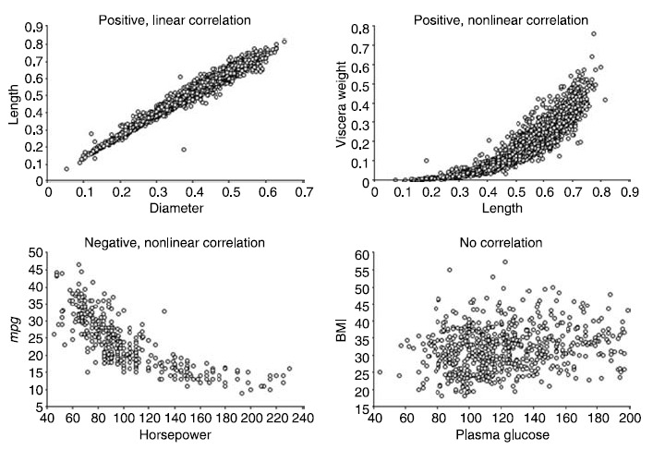
Scatterplots
For continuous variables
Positive or negative or no relationship at all
linear or nonlinear relationships
Outlier detection

Slide 5
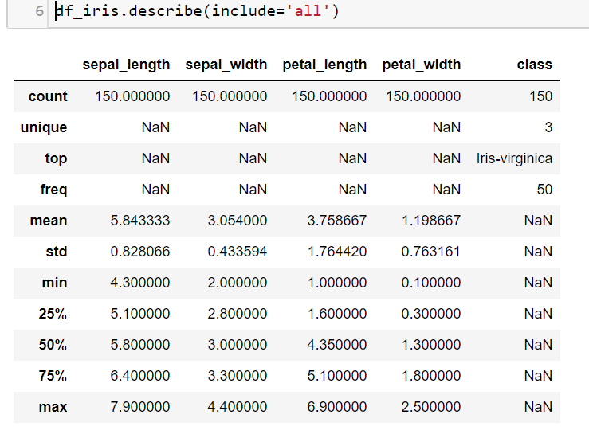
Summary tables – describe method
Generates descriptive statistics that summarize the central tendency, dispersion and shape of a dataset’s distribution, excluding NaN values.
Analyzes both numeric and object series, as well as DataFrame column sets of mixed data types.
The output will vary depending on what is provided.

Slide 6
METRICS ABOUT RELATIONSHIPS
Correlation Coefficients
Kendall Tau
t-Tests Comparing Two Groups
ANOVA
Chi-Square

Slide 7
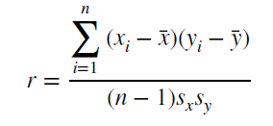
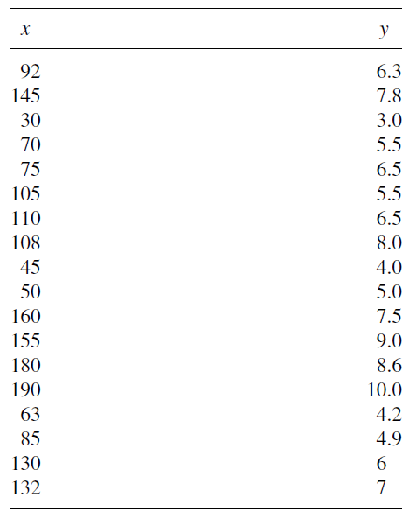
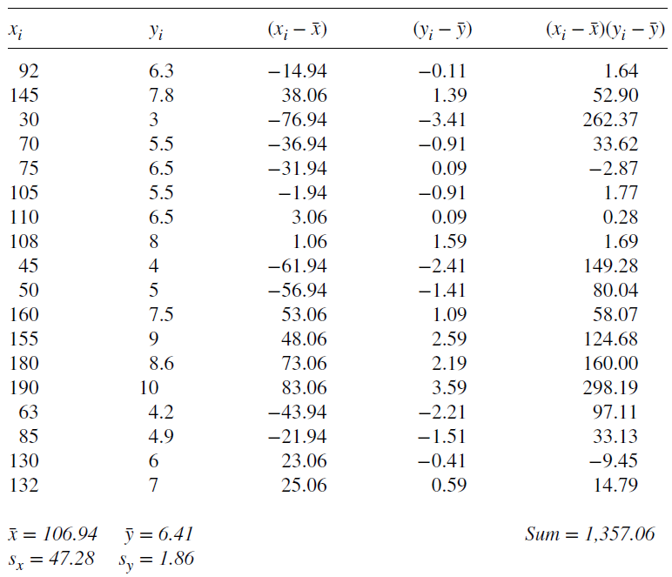
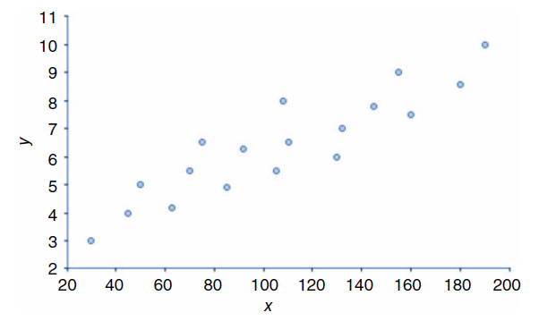
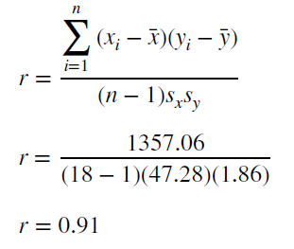
Correlation Coefficient
r = correlation coefficient
The formula used to calculate r is

Slide 8
Kendall Tau (Rank correlation)
based on a ranking of the observations for two variables
based on counts of concordant and discordant pairs of observations.
observations A and B, Variables X, Y
concordant | discordant
difference of the values for Variable X (X_{B} − X_{A} or 2 − 1 = 1) difference of the values for Variable Y (Y_{B} − Y_{A} or 4 − 2 = 2).
Since these differences are in the same direction— 1 and 2 are both positive—the observations A and B are concordant | A discordant pair occurs when the differences of the two variables’ values move in opposite directions.

Slide 9
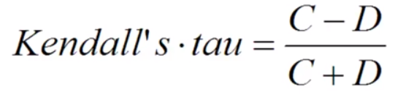
explanation
Observation name | Variable X | Variable Y | Concordant | Discordant
A | 1 | 2 | 8 | 1
B | 2 | 4 | 6 | 2
C | 3 | 1 | 7 | 0
D | 4 | 3 | 6 | 0
E | 5 | 6 | 4 | 1
F | 6 | 5 | 4 | 0
G | 7 | 7 | 2 | 1
H | 8 | 8 | 2 | 0
I | 9 | 10 | 0 | 1
J | 10 | 9 | 0 | 0
 |  | SUM | 39 | 6
the observations A–J are ordered using Variable X, and each unique pair of observations is compared.
A is compared with all other observations (B, C, . . . , J) and the number of concordant and discordant pairs are counted
For observations A, there are eight concordant pairs (A–B, A–D, A–E, A–F, A–G, A–H, A–I, A–J) and one discordant pair (A–C).
repeated for all other observations
Observation B is compared to observations C through J, observation C compared to D though J, and so on.
Range between -1 to 1
1 indicating a perfect ranking
−1 a perfect disagreement of the rankings.
A zero value— assigned when the ranks are tied —indicates a lack of association,
Cannot SQ the coeff to get coeff of determination
𝜏_{A} = (39 − 6) / 45
𝜏_{A} = 0.73

Slide 10
interpretation
The Kendall’s rank correlation coefficient can be calculated in Python using the kendalltau() SciPy function.
The test takes the 2 data samples as arguments and returns
the correlation coefficient and
the p-value.
As a statistical hypothesis test, the method assumes (H₀) that there is no association between the two samples.

Slide 11
t-Tests Comparing Two Groups
The t test (also called Student’s T Test) compares two means and tells us if they are different from each other. The t test also tells us how significant the differences are
This concept can be extended to compare the mean values of two subsets. We can explore if the means of two groups are different enough to say the difference is significant → differentiability
binary classification problem,
each observation can be classified either into class C1 or class C2,
t-Statistics helps us evaluate if the values of a particular feature for class C1 is significantly different from values of same feature for class C2.
If this holds, then the feature can helps us to better differentiate our data.

Slide 12
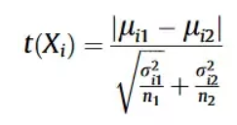
explanation
Does the salary of a person impact his chances to get a loan ?
Calculate mean and variance
Salaries of individuals when the loan was approved
Salaries of individuals when the loan was not approved
Use t-statistics to check whether these two samples are significantly different or not.
t- Statistics is computed using:
calculate the t-Statistic for each feature,
sort these values in descending order in order to select the important features.

Slide 13
Interpretation
If abs(t-statistic) <= critical value →Accept null hypothesis that the means are equal.
If abs(t-statistic) > critical value →Reject the null hypothesis that the means are equal.
the first mean is smaller or greater than the second mean.
If p > alpha → Accept null hypothesis that the means are equal.
If p <= alpha → Reject null hypothesis that the means are equal.

Slide 14
Chi-square test
for use with variables measured on a categorical (nominal or ordinal) features.
When to Use the Chi-Square Goodness of Fit Test
The sampling method is simple random sampling.
The variable under study is categorical.
The expected value of the number of sample observations in each level of the variable is at least 5.

Slide 15


Chi-square test
allows an analysis of whether there is a relationship between two categorical variables.
Null Hypothesis: The two categorical variables are independent.
Alternative Hypothesis: The two categorical variables are dependent.
The chi-square test statistic is calculated by using the formula:
O represents the observed frequency.
E is the expected frequency under the null hypothesis & computed by:

Slide 16
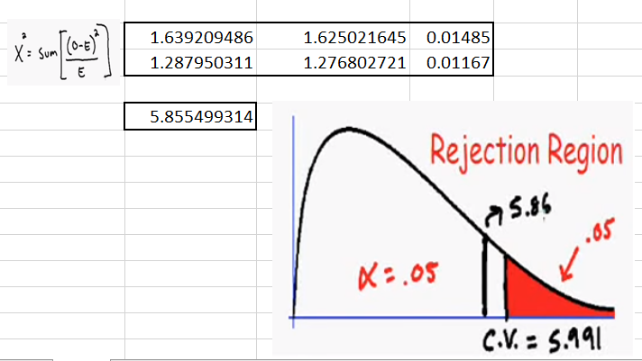
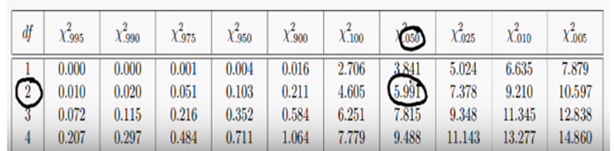
Chi-square test
Interpretation

Slide 17
ANOVA (One-Way)
The analysis of variance (ANOVA) can be thought of as an extension to the t-test.
The independent t-test is used to compare the means of a condition between 2 groups but sometimes we want to compare more than 2 groups
E.g. to test whether voter age differs based on some categorical variable like race/Education level,
compare the means of each level.
Alternatively, a separate t-test for each pair of groups,
The analysis of variance or ANOVA is a statistical inference test that lets you compare multiple groups at the same time.
H₀: No difference between means, i.e. ͞x₁ = ͞x₂ = ͞x₃
H_{a}: Difference between means exist somewhere, i.e. ͞x₁ ≠ ͞x₂ ≠ ͞x3, or ͞x1 = ͞x2 ≠ ͞x3, or ͞x1 ≠ ͞x2 = ͞x3

Slide 18
assumption
There are 3 assumptions that need to be met for the results of an ANOVA test to be considered accurate and trust worthy. It’s important to note the the assumptions apply to the residuals and not the variables themselves.
The ANOVA assumptions are the same as for linear regression and are:
Normality - Caveat to this is, if group sizes are equal, the F-statistic is robust to violations of normality
Homogeneity of variance - Same caveat as above, if group sizes are equal, the F-statistic is robust to this violation
Independent observations

